Slide 1
North Carolina Healthy Blue
EVV HH Informational Session

Slide 2
21st Century Cures Act
CareBridge Mission & EVV Introduction
Provider Onboarding & Milestones
Home Health Services (HHS)
Resources
Contacts

Slide 3
21st Century Cures Act & EVV
Section 12006(a) of the 21st Century Cures Act mandates that states implement
EVV for all Medicaid personal care services (PCS) and home health services (HHCS)
that require an in-home visit by a provider.
Electronic Visit Verification (EVV) is the process by which a service performed for a member at home or in the community is verified electronically
An EVV system must be able to electronically verify, with respect to visits conducted as part of personal care services or home health care services, the following:
  the type of service performed;
  the individual receiving the service;
  the date of the service;
  the location of service delivery;
  the individual providing the service; and
  the time the service begins and ends
Notes:
Client Success

Slide 4
21st Century Cures Act
CareBridge Mission & EVV Introduction
Provider Onboarding & Milestones
Home Health Services (HHS)
Resources
Contacts

Slide 5



CareBridge’s Mission
CareBridge exists to enable individuals in home and community-based settings (HCBS) to maximize their health, independence, and quality of life
WE ACCOMPLISH OUR MISSION BY:
Ensuring HCBS members receive individualized, reliable, and appropriate care to promote greater independence
Providing members and caregivers with access to a highly trained clinical team 24/7
Coordinating closely with PCPs, Care Coordinators, and other care team members
Delivering solutions that address physical and behavioral health needs and promote health equity
Notes:
Client Success

Slide 6
CareBridge EVV Solutions
CareBridge is a comprehensive EVV Solution, Data Aggregation Engine, and Claim Engine
Our Provider EVV Solution:
  The Mobile Platform & IVR capabilities are designed for ease-of-use for Caregivers’ check-in and check-out process
  The Provider Portal enables providers to manage their EVV services, members, and billing
  The Member Portal allows members to attest to visits and provide service-specific feedback
Our Payer Products:
  The Payer Portal allows states and payers real-time insights on EVV adoption, care delivery, claim payments, etc.
  The Data Aggregation Engine ingests EVV visit data at Third-Party EVV Vendors and the CareBridge EVV Solution and validates visit data according to Payer data files and established business rules
  The Claim Engine uses validated EVV visit data to generate claims (837p or 837i) and sends claims to the Payer (via clearinghouse) for adjudication
Notes:
Client Success

Slide 7
EVV Stakeholder Responsibilities
Provider Agencies
Provide Care to Members
Train Employees on EVV Expectations
Manage Member, Authorization, Scheduling, and Visit Data
Review & Resolve Alerts
Manage Third-Party EVV Vendor
Drive Third-Party EVV Vendor Integration
Stay Informed on EVV Related Policy Updates & Developments
Third-Party EVV Vendor
Configure EVV Solution consistent with CMS, State, and PHP requirements (e.g., Scheduling, Missed Visits, Manual Entries, Overlapping Visits, Group Visits, etc.)
Integrate with PHP Aggregator
Capture EVV Visit Data
Transmit EVV Visit Data to PHP Aggregator
Share Response Reporting with Contracted Providers
Support Provider Inquiries Related to EVV System & Configuration
PHP
- Healthy Blue -
Make EVV Configuration Decisions
Drive Outreach & Communication to Provider Agencies
Provide Claim Status Updates to PHP Aggregator
Adjudicate Claims & Deliver 835 to Provider Agencies
Monitor EVV Adoption & Utilization
Support Provider Inquiries related to Service Delivery, EVV Configuration, and Claims Submission & Status
PHP
Aggregator
- CareBridge -
Ingest PHP Data related to Members, Providers, and Authorizations
Ingest EVV Visit Data at integrated Third-Party EVV Vendors
Validate EVV Visit Data
Deliver Response Reporting to Third-Party EVV Vendors
Generate EDI Claim Files based on EVV Visit Data
Submit Claims to PHP
Support Provider Inquiries Related to EVV Alerts, Configurations, and Requirements
State Medicaid
Agency
- DHHS -
Establish EVV Policy
Set Guidelines for EVV Adoption & Adherence
Monitor EVV KPIs for CMS Reporting
Receive Required EVV Reporting at PHPs
Validate Adherence to State Program Rules

Slide 8

High-level Workflow
1. Providers use EVV system to capture/correct necessary data. EVV vendor sends data to CareBridge to generate claim.
2. CareBridge EVV Aggregation platform applies applicable EVV, claims, and program/state business rules.
3. CareBridge returns pre-billing validation errors to EVV vendors with the expectation that these are passed on to providers for resolution. *when applicable
4. Providers resolve errors in their EVV system and resubmit visit to CareBridge.
*when applicable
PHP Data
Member
Provider
Authorization
EVV Visits Data
CareBridge Users
&
Third-Party EVV Systems Users
3
PROVIDER
4
2
5
Clearinghouse
6
PHPs
1
7
8
5. CareBridge generates and sends validated claims via 837 format to Clearinghouse.
6. Applicable claims data sent to PHPs via Clearinghouse. Claim details/status returned to Clearinghouse.
7. Clearinghouse returns claim details/status to CareBridge through file exchange process (277CA).
8. PHPs return remit (835) information to providers through existing process.

Slide 9
21st Century Cures Act
CareBridge Mission & EVV Introduction
Provider Onboarding & Milestones
Home Health Services (HHS)
Resources
Contacts

Slide 10
Provider Onboarding – All EVV Users
All New EVV Users
Complete the Provider Setup & Access Request Form
  The respondent should be familiar with claims, billing/EDI, authorization process, and current EVV solution
  Respondent will need to provide information regarding:
    Company legal name and identification numbers (e.g., tax id, NPI)
    Current company contact information EVV/billing administrator and contact information
    EVV Vendor selection (and contact information if not using CareBridge)
Notes:
http://resourcelibrary.carebridgehealth.com/tnevv

Slide 11
Provider Onboarding – CareBridge EVV Users
CareBridge Users
Complete Training
  Complete On Demand Training Sessions
  Review Materials in the CareBridge Resource Library
Log into the CareBridge Portal
  Set up your office in the CareBridge portal
Acknowledge an Authorization / Schedule an Appointment
Complete an EVV visit using CareBridge EVV
Submit a claim via CareBridge EVV
Notes:
http://resourcelibrary.carebridgehealth.com/tnevv

Slide 12
Provider Onboarding – Third-Party EVV Users
Third-Party EVV Users
Have your EVV Vendor complete the Third-Party EVV Intake Form
  Providers should review the Integrated Agency Portal User Guide
  Third-Party Vendors should review the North Carolina Integration Guide and Technical Specifications for instructions on obtaining credentials for both testing and production environments
Third-Party Vendor receives credentials
  CareBridge sends this information directly to your vendor
Third-Party Vendor completes testing with CareBridge
Third-Party Vendor sends production data to CareBridge
Submit a claim via CareBridge
Notes:
https://evvintegrationeform.carebridgehealth.com/

Slide 13
21st Century Cures Act
CareBridge Mission & EVV Introduction
Provider Onboarding & Milestones
Home Health Services (HHS)
Resources
Contacts

Slide 14
Home Health Servies (HHS)
Hard Launch was October 1, 2025
Providers have a choice of billing through EVV on an 837i or billing Healthy Blue directly
All services are “Sometimes Authorized.” This means that Healthy Blue may require an authorization be present in the CareBridge EVV system under certain situations. Prior Authorizations may still be required by Healthy Blue even if they are not sent to CareBridge.

Slide 15
Sometimes Authorized Services
CareBridge User
An authorization for the service is sent to CareBridge by the PHP: | Visits for these services must be associated to the authorization received by CareBridge from the PHP. This authorization number must match to an authorization received by CareBridge from the PHP. If the ‘AuthRefNumber’ field is blank, CareBridge will attempt to match to an authorization using other provided data elements.
An authorization for the service is not sent to CareBridge by the PHP: | Providers must follow the “No Authorization Workflow” as covered in the following training materials: Micro Learning: CareBridge Provider Portal - No Authorizations Reference Document: No Authorization Workflow
IMPORTANT: If a provider has received an authorization but cannot find it in the CareBridge system, they should contact their PHP point of contact.

Slide 16
Sometimes Authorized Services
Third-Party EVV Vendor User
An authorization for the service is sent to CareBridge by the PHP: | EVV visit data sent to CareBridge for these services must include the correct authorization number in the ‘AuthRefNumber’ field. This authorization number must match to an authorization received by CareBridge from the PHP. If the ‘AuthRefNumber’ field is blank, CareBridge will attempt to match to an authorization using other provided data elements. If a match is found, the visit will be associated to this authorization number. If a match is not found the visit will be treated as if an authorization was not sent to CareBridge by the PHP.
An authorization for the service is not sent to CareBridge by the PHP: | EVV visit data sent to CareBridge for these services must be sent with the ‘AuthRefNumber’ field blank (null). If the ‘AuthRefNumber’ field is sent to CareBridge with a value, an alert will be returned to the Provider / Third-Party EVV Vendor in the CareBridge response file.
IMPORTANT: If a provider has received an authorization but cannot find it in the CareBridge system, they should contact their PHP point of contact.

Slide 17
Home Health Services – EVV Required
HCPC | Rev Code | Rev Code Description
G0299 | 551 | Skilled nursing: Treatment, teaching/training, observation/evaluation
 | 559 | Skilled nursing: For a dually eligible beneficiary when the visit does not meet Medicare criteria
 | 580 | Skilled nursing: venipuncture
 | 581 | Skilled nursing: Pre- filling insulin syringes/Medi- Planners
G0300 | 551 | Skilled nursing: Treatment, teaching/training, observation/evaluation
 | 559 | Skilled nursing: For a dually eligible beneficiary when the visit does not meet Medicare criteria
 | 580 | Skilled nursing: venipuncture
 | 581 | Skilled nursing: Pre- filling insulin syringes/Medi- Planners
G0493 | 550 | Skilled nursing: Initial assessment/re- assessment
G0494 | 550 | Skilled nursing: Initial assessment/re- assessment
G0495 | 551 | Skilled nursing: Treatment, teaching/training, observation/evaluation
 | 559 | Skilled nursing: For a dually eligible beneficiary when the visit does not meet Medicare criteria
G2168 | 420 | Physical Therapy
G2169 | 430 | Occupational Therapy
S9122 | 570 | Home Health Aide Visit
S9123 | 551 | Skilled nursing: Treatment, teaching/training, observation/evaluation
 | 559 | Skilled nursing: For a dually eligible beneficiary when the visit does not meet Medicare criteria
S9124 | 551 | Skilled nursing: Treatment, teaching/training, observation/evaluation
 | 559 | Skilled nursing: For a dually eligible beneficiary when the visit does not meet Medicare criteria
 | 580 | Skilled nursing: venipuncture
 | 581 | Skilled nursing: Pre- filling insulin syringes/Medi- Planners
S9128 | 440 | Speech Therapy
S9129 | 430 | Occupational Therapy
S9131 | 420 | Physical Therapy
T1001 | 551 | Skilled nursing: Nursing assessment/evaluation
T1002 | 551 | Skilled nursing: Treatment, teaching/training, observation/evaluation
 | 559 | Skilled nursing: For a dually eligible beneficiary when the visit does not meet Medicare criteria
T1021 | 570 | Home Health Aide Visit
T1030 | 551 | Nursing Care, In The Home, By Registered Nurse

Slide 18
Home Health Services – EVV Required
HCPC | Revenue Code | Revenue Code Description
92521 | 444 | Speech Therapy – Evaluation
92522 | 444 | Speech Therapy – Evaluation
92523 | 444 | Speech Therapy – Evaluation
97161 | 424 | Physical Therapy – Evaluation
97162 | 424 | Physical Therapy – Evaluation
97163 | 424 | Physical Therapy – Evaluation
97164 | 424 | Physical Therapy – Evaluation
97165 | 434 | Occupational Therapy – Evaluation
97166 | 434 | Occupational Therapy – Evaluation
97167 | 434 | Occupational Therapy – Evaluation
97168 | 434 | Occupational Therapy – Evaluation
G0151 | 420 | Physical Therapy
G0152 | 430 | Occupational Therapy
G0153 | 440 | Speech Therapy
G0156 | 570 | Home Health Aide Visit
G0157 | 420 | Physical Therapy
G0158 | 430 434 | Occupational Therapy – Evaluation
G0159 | 420 | Physical Therapy
 | 424 | Physical Therapy – Evaluation
G0160 | 430 | Occupational Therapy
 | 434 | Occupational Therapy – Evaluation
G0161 | 440 | Speech Therapy
G0162 | 550 | Skilled nursing: Initial assessment/re- assessment
G0283 | 420 | Physical Therapy

Slide 19
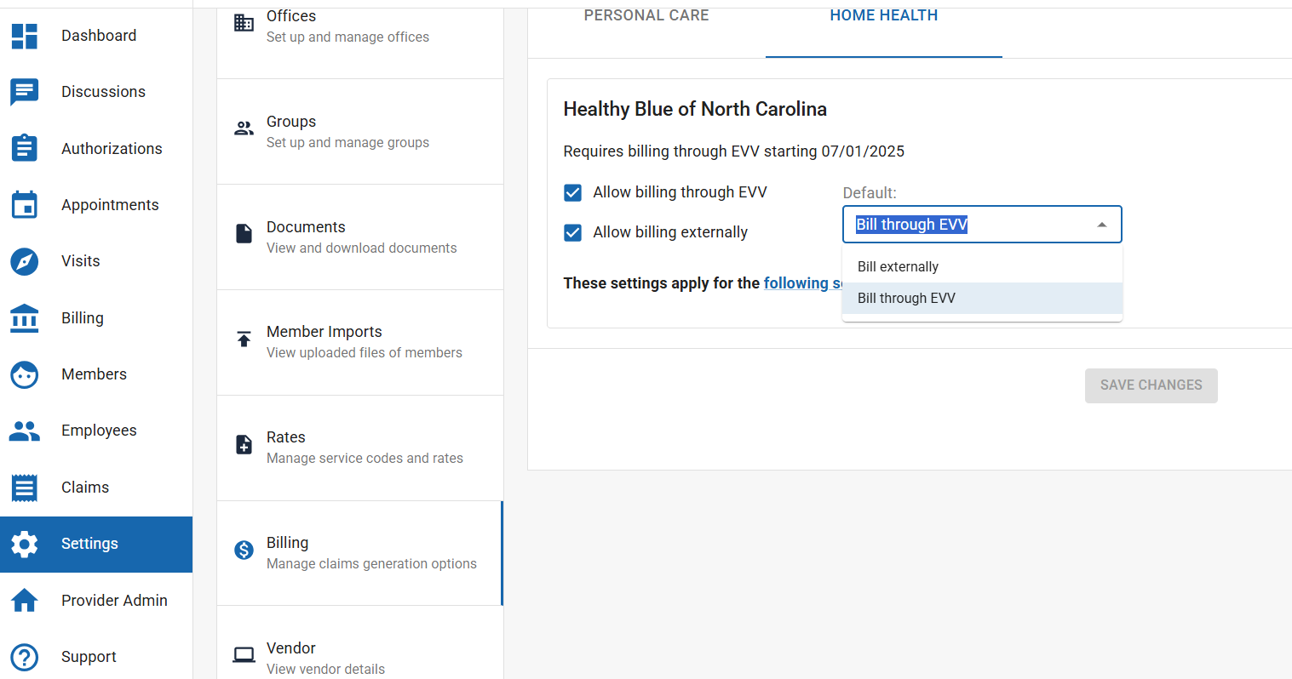
Direct Billing - CareBridge Users
CareBridge Provider Admins can check both options, choosing their billing path on a per visit basis

Slide 20
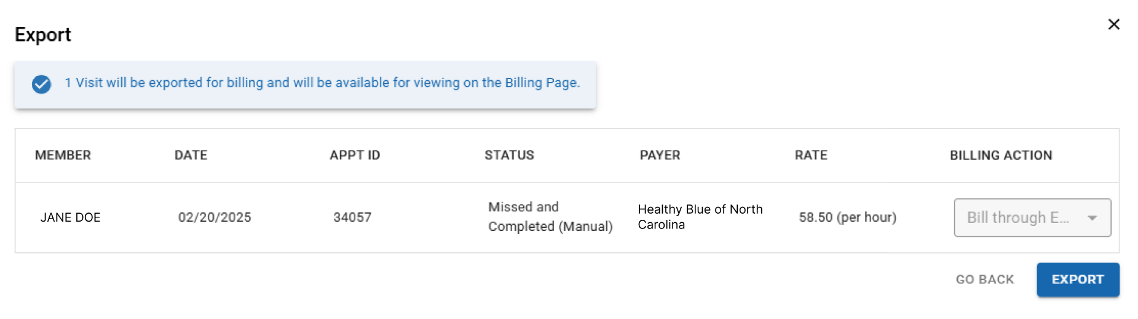
Direct Billing – CareBridge Users
Providers can select whether individual visits are billed through EVV or directly when exporting for billing

Slide 21
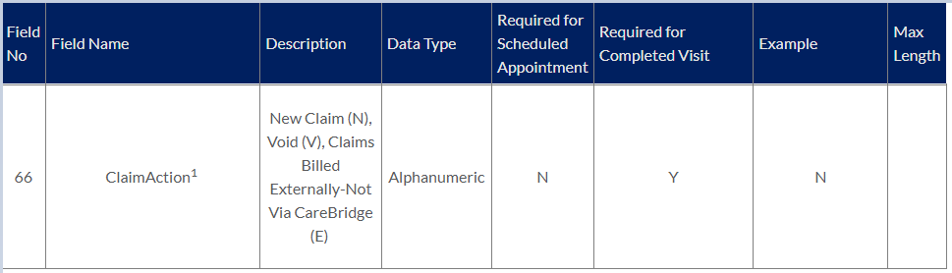
Direct Billing – Third-Party EVV Users
Visit data is sent on the EVV Visit File containing a ‘ClaimAction’ indicator
E = Billed Externally
  CareBridge does not generate a claim
N = Claim
  CareBridge will generate a claim and submit to the payer

Slide 22
21st Century Cures Act
CareBridge Mission & EVV Introduction
Provider Onboarding & Milestones
Home Health Services (HHS)
Resources
Contacts

Slide 23
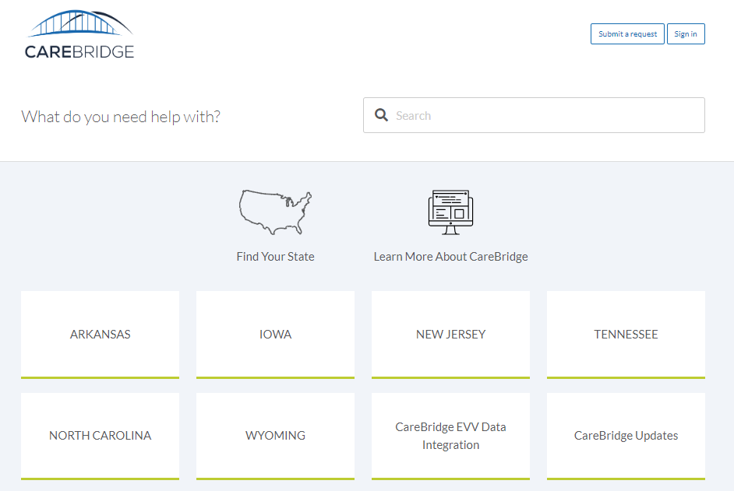
How to “Follow” Critical Resources
Access the CareBridge Resource Library and select “Sign In”

Slide 24
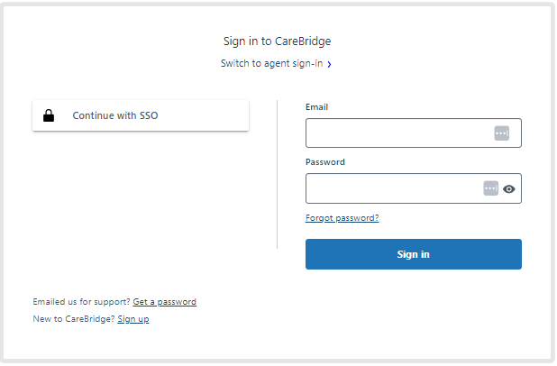
How to “Follow” Critical Resources
Sign in or Create an Account
  If you already have an account, sign in using your credentials.
  If you do not have an account, create one by following the registration instructions on the sign-in page.

Slide 25
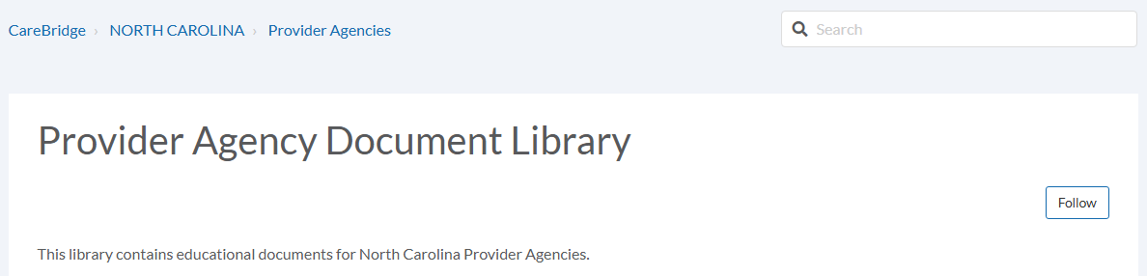

How to “Follow” Critical Resources
Access the Resource Library Section
  Once logged in, browse to the section of the Resource Library that contains the materials you need.
  Click on the “Follow” button next to the resource or section you are interested in.
  To confirm you are following, look for a message that says, “You are now following this article.”
  As new information is added to the sections you are following, you will automatically receive email notifications, ensuring you are always up-to-date.

Slide 26
21st Century Cures Act
CareBridge Mission & EVV Introduction
Provider Onboarding & Milestones
Home Health Services (HHS)
Resources
Contacts

Slide 27
Healthy Blue Points of Contact
North Carolina Healthy Blue
    Reach out to your Provider Relationship Account Consultant directly, or contact Provider Relations using the information below:
    Phone: 844-594-5072
    Provider Relations Email: NC_Provider_Training@healthybluenc.com
North Carolina DHHS:
Website: https://medicaid.ncdhhs.gov/EVV
Email: Medicaid.evv@dhhs.nc.gov

Slide 28
CareBridge Points of Contact
Please reach out to CareBridge Support, for example re: EVV Vendor Setup, pre-billing alerts:
  Email: ncevv@carebridgehealth.com
Third-Party EVV Integration, for example re: pre-billing alerts:
  Email: evvintegrationsupport@carebridgehealth.com
Third-Party Vendors, technical contacts only:
  Email: evvintegration@carebridgehealth.com

