Slide 1
AR Informational Session
AR CareSource & Summit Home Health Services EVV
March 11, 2025
March 27, 2025
April 15, 2025
May 15, 2025

Slide 2
Welcome and Introductions
Presentation Objectives & Overview
EVV Overview & Timeline
Provider Onboarding & Actions
Home Health Services & Authorization Issuance Types
Communication & Resources
Next Steps & Points of Contact

Slide 3
Welcome and Introductions
Presentation Objectives & Overview
EVV Overview & Timeline
Provider Onboarding & Actions
Home Health Services & Authorization Issuance Types
Communication & Resources
Next Steps & Points of Contact

Slide 4
Presentation Objectives
To implement these changes, CareSource, Summit Community Care, and CareBridge are all committed to keeping providers up-to-date on timing, milestones, training, and key next steps. The objectives of this presentation are to:
Outline the project plan, timing, and key dates for providers and Third-Party EVV Vendors
Provide more details about home health services impacted
Inform providers about communication and training channels
Share resources to providers and Third-Party EVV Vendors to be prepared for the changes
By the end of this presentation, providers should have the necessary information to:
Stay informed about changes, timing, and milestones, and plan to attend training
Plan to involve Third-Party EVV Vendors, as necessary
Know where to provide feedback and seek support

Slide 5
Welcome and Introductions
Presentation Objectives & Overview
EVV Overview & Timeline
Provider Onboarding & Actions
Home Health Services & Authorization Issuance Types
Communication & Resources
Next Steps & Points of Contact

Slide 6
EVV Overview
What is EVV?
Who is CareBridge?
Electronic Visit Verification (EVV) uses technology to electronically record when a caregiver begins and ends providing home health services (HHS) to Medicaid members
EVV solutions work on a device such as a smartphone, GPS-enabled tablet, or landline to collect the caregivers’ start and end times
The requirements for a compliant EVV system are outlined in the 21st Century Cures Act, a federal law that requires all states to implement EVV
EVV captures the following:
Type of service provided
Member receiving the service
Caregiver providing the service
Date of the service
Location of the service delivery
Time the service begins and ends
CareBridge is a technology company that helps states, the PASSE, and providers deliver the best care for Home Community Based Services (HCBS) members
We have a comprehensive, best-in-class CareBridge EVV Solution, Data Aggregator, and Claim Engine
Providers can use the free CareBridge EVV solution or use their own compliant EVV system through integration with CareBridge
CareBridge is:
A partner to ensure success under the 21st Century Cures Act
An established EVV and EVV data aggregation vendor
An experienced team with a track record of successful statewide implementations

Slide 7
EVV Decision – Your Options
Option 1: CareBridge EVV Solution
You can use CareBridge’s EVV solution to ensure compliance
The CareBridge EVV solution is at no cost to providers
Includes access to a suite of provider management solutions
Option 2: Connect your Third-Party EVV Vendor with CareBridge via Integration
Even if you don’t use CareBridge, your EVV vendor must integrate to share EVV visit data with CareBridge, and all Home Health claims must be generated by CareBridge EVV
Integration with CareBridge is free to both providers and your EVV vendors
If you are using a Third-Party EVV Vendor, Complete the eForm: http://evvintegrationeform.carebridgehealth.com/
Regardless of EVV Vendor Selection, you must complete the Provider Setup & Access Request Form
Provider Setup & Access Request Form: https://ar.carebridgehealth.com/register-provider/new-registration

Slide 8
Timeline & Critical Activities
The timeline below outlines the critical activities and actions for Providers and Third-Party EVV Vendors over the few months.
Timeline
EVV Informational Sessions
Third-Party EVV Vendors: Access Updated CareBridge EVV Technical Specifications & Testing with CareBridge Open
Hard Denial Date
Feb 6
Providers: Informational Sessions Begin
Mar 11
2025
Feb
Mar
Apr
May
Jun ->
Mar 11
Mar 27
Apr 15
May 15
May 30
Providers: Informational Sessions
Mar 12 - May 15
Providers: Communication & Engagement
Mar 3 – Jun ->
Third-Party EVV Vendors: Development
Feb 6 – May 30
Providers: Training & Educations
Mar 3 - Jun ->

Slide 9
Welcome and Introductions
Presentation Objectives & Overview
EVV Overview & Timeline
Provider Onboarding & Actions
Home Health Services & Authorization Issuance Types
Communication & Resources
Next Steps & Points of Contact

Slide 10
Provider Onboarding
CareBridge Users
Third-Party EVV Vendor Users
Complete the Provider Setup & Access Request Form
Complete On Demand Training Sessions
Review Materials in the CareBridge Resource Library
Log into the CareBridge Portal
Set up your office in the CareBridge portal
Acknowledge an Authorization / Schedule an Appointment
Complete an EVV visit using CareBridge EVV
Submit a claim via CareBridge EVV
Complete the Provider Setup & Access Request Form
Have your EVV Vendor complete the Third-Party EVV Intake Form
Review the Integrated Agency Portal User Guide
Vendor receives credentials
CareBridge sends this information directly to your vendor
Vendor completes testing with CareBridge
Vendor sends production data to CareBridge
Submit a claim via CareBridge

Slide 11
Provider Actions
ALL PROVIDERS
Complete the required Provider Setup & Access Request Form.
https://ar.carebridgehealth.com/register-provider/new-registration
The respondent should be familiar with claims, billing/EDI, authorization process, and current EVV solution
Respondent will need to provide information regarding:
Company legal name and identification numbers (e.g., tax id, NPI)
Current company contact information EVV/billing administrator and contact information
EVV Vendor selection (and contact information if not using CareBridge)
PROVIDERS USING A THIRD-PARTY EVV VENDOR
Your EVV Vendor must complete the required Third-Party EVV Vendor Intake Form.
http://evvintegrationeform.carebridgehealth.com/
EVV vendors are required to complete this intake form to initiate integration activities with CareBridge
EVV vendors should review the state specific Integration Guide and Technical Specifications for instructions on obtaining credentials for both testing and production environments: http://evvintegration.carebridgehealth.com/

Slide 12
Welcome and Introductions
Presentation Objectives & Overview
EVV Overview & Timeline
Provider Onboarding & Actions
Home Health Services & Authorization Issuance Types
Communication & Resources
Next Steps & Points of Contact

Slide 13
Required Codes
Below is a comprehensive list of codes that are required for Electronic Visit Verification (EVV) compliance. These codes must be accurately captured and reported via your EVV system to ensure adherence to regulatory requirements and proper claims processing.
Procedure Codes & Modifiers | Procedure Name | Unit of Measure | Claim Type | Auth Issuance Type | Revenue Code
S9131 | Home Health Physical Therapy - Therapist | Per Visit | 837i | Always | 0421
S9131 UB | Home Health Physical Therapy - Assistant | Per Visit | 837i | Always | 0421
T1021 | Home Health Aide Visit | Per Visit | 837i | Sometimes | 0551
T1021 TD | Home Health RN Visit | Per Visit | 837i | Sometimes | 0551
T1021 TE | Home Health LPN Visit | Per Visit | 837i | Sometime | 0551

Slide 14
Authorization Issuance Types
For Home Health EVV required services there are 2 different Authorization Issuance Types that Providers and Third-Party EVV Vendors should become familiar with.
1
ALWAYS
These services will always require an authorization to be present in the CareBridge system for EVV visits to be captured.
2
SOMETIMES
These services will only require an authorization to be present in the CareBridge system some of the time for EVV visits to be captured.

Slide 15
Always
When a service is listed as “Always” as the Auth Issuance Type, the PASSE requires that a valid authorization be present in the CareBridge system before an EVV visit can be captured.
CareBridge User
Visits for these services must be associated to the authorization received by CareBridge from the PASSE. If services need to be rendered prior to the authorization being available in the CareBridge system, a manual entry may be necessary after the visit took place.
IMPORTANT: If a provider has received an authorization but cannot find it in the CareBridge system, they should contact their PASSE point of contact.

Slide 16
Always
When a service is listed as “Always” as the Auth Issuance Type, the PASSE requires that a valid authorization be present in the CareBridge system before an EVV visit can be captured.
Third-Party EVV Vendor User
EVV visit data sent to CareBridge for these services must include the correct authorization number in the ‘AuthRefNumber’ field. This authorization number must match to an authorization received by CareBridge from the PASSE If the authorization number does not match what the PASSE sent to CareBridge, an alert will be returned to the Provider / Third-Party EVV Vendor in the CareBridge response file.
IMPORTANT: If a provider has received an authorization but cannot find it in the CareBridge system, they should contact their PASSE point of contact.

Slide 17
Sometimes
When a service is listed as “Sometimes” as the Auth Issuance Type, the PASSE requires that a valid authorization be present in the CareBridge system in some situations before an EVV visit can be captured.
Ex. authorization is required for out-of-network Provider, authorization is not required for initial # visits, etc.
CareBridge User
An authorization for the service is sent to CareBridge by the PASSE: | Visits for these services must be associated to the authorization received by CareBridge from the PASSE. This authorization number must match to an authorization received by CareBridge from the PASSE. If the ‘AuthRefNumber’ field is blank, CareBridge will attempt to match to an authorization using other provided data elements.
An authorization for the service is not sent to CareBridge by the PASSE: | Providers must follow the “No Authorization Workflow” as covered in the following training materials: Micro Learning: CareBridge Provider Portal - No Authorizations Reference Document: No Authorization Workflow
IMPORTANT: If a provider has received an authorization but cannot find it in the CareBridge system, they should contact their PASSE point of contact.

Slide 18
Sometimes
When a service is listed as “Sometimes” as the Auth Issuance Type, the PASSE requires that a valid authorization be present in the CareBridge system in some situations before an EVV visit can be captured.
Ex. authorization is required for out-of-network Provider, authorization is not required for initial # visits, etc.
Third-Party EVV Vendor User
An authorization for the service is sent to CareBridge by the PASSE: | EVV visit data sent to CareBridge for these services must include the correct authorization number in the ‘AuthRefNumber’ field. This authorization number must match to an authorization received by CareBridge from the PASSE. If the ‘AuthRefNumber’ field is blank, CareBridge will attempt to match to an authorization using other provided data elements. If a match is found, the visit will be associated to this authorization number. If a match is not found the visit will be treated as if an authorization was not sent to CareBridge by the PASSE.
An authorization for the service is not sent to CareBridge by the PASSE: | EVV visit data sent to CareBridge for these services must be sent with the ‘AuthRefNumber’ field blank (null). If the ‘AuthRefNumber’ field is sent to CareBridge with a value, an alert will be returned to the Provider / Third-Party EVV Vendor in the CareBridge response file.
VCR2012 - Visit does not have an associated authorization
IMPORTANT: If a provider has received an authorization but cannot find it in the CareBridge system, they should contact their PASSE point of contact.

Slide 19
Welcome and Introductions
Presentation Objectives & Overview
EVV Overview & Timeline
Provider Onboarding & Actions
Home Health Services & Authorization Issuance Types
Communication & Resources
Next Steps & Points of Contact

Slide 20
Communication & Training Channels
As part of this process, CareBridge, CareSource, and Summit Community Care will leverage several communication and training channels to ensure that all providers are aware of and prepared for the upcoming updates to claim elements.
Communication Channels | Training Channels
CareBridge EVV Training & Resource Site Announcements: For documentation, FAQs, support materials, and interactive tutorial resources | Interactive EVV Training and Resource Site, PASSE System Configuration Update Pages, Arkansas DHS Informational Resource Site: Centralizes all training materials and support resources in one place
PASSE System Configuration Update Pages: For providing information related to the impending changes | Step-by-Step Video Tutorials: Provide visual and practical instructions for the changes
Arkansas DHS Informational Letters & Notifications: For formal announcements, updates, and detailed instructions | Comprehensive User Guides and Manuals: Serve as thorough reference materials for providers
PASSE Direct Provider Outreach: For reminders, letters, and direct communication with their network of providers | FAQs and Knowledge Base Articles: Provide quick answers and solutions to common questions and challenges
PASSE & CareBridge Direct Outreach: For personalized outreach and working sessions with a trusted resource | Recorded Training Video: Allow providers to access key information on their own timeline
CareBridge Support Center & Provider Success Teams: For direct assistance and troubleshooting

Slide 21
Resources
Arkansas Quick Links
Resource Library Home Page: The landing page for the CareBridge Resource Library - here you have access to the information and resources available for CareBridge and Third-Party EVV Vendor users.
CareBridge Arkansas State Page: The CareBridge Arkansas state page houses training documents and videos for multiple user categories including Caregivers, Payer/PASSE, and Provider Agencies.
Provider Training Registration: Direct location for on demand training for provider agencies
To ensure you have the latest training materials and documentation from CareBridge, follow these next steps to access and subscribe to updates from the Resource Library. Please also share this information with Third-party EVV Vendors to ensure effective integrations.

Slide 22
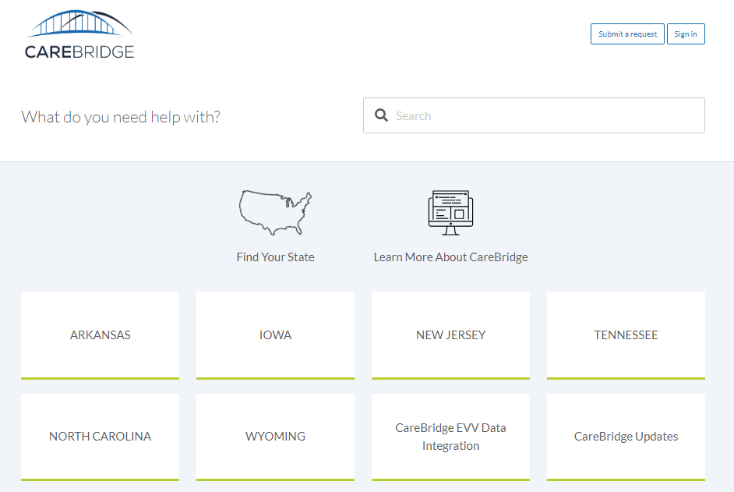
“Follow” Critical Resources
1.) Visit the CareBridge Resource Library
Click here for direct access and select “Sign In”

Slide 23
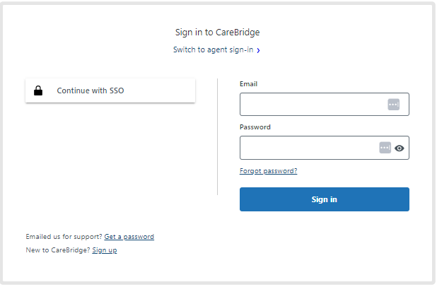
“Follow” Critical Resources
2.) Sign In or Create an Account
If you already have an account, sign in using your credentials.
If you do not have an account, create one by following the registration instructions on the sign-in page.

Slide 24
“Follow” Critical Resources
3.) Access the Resource Library Section
Once logged in, browse to the section of the Resource Library that contains the materials you need.
Click on the “Follow” button next to the resource or section you are interested in.
To confirm you are following, look for a message that says, “You are now following this article.”
As new information is added to the sections you are following, you will automatically receive email notifications, ensuring you are always up-to-date.

Slide 25
Welcome and Introductions
Presentation Objectives & Overview
EVV Overview & Timeline
Provider Onboarding & Actions
Home Health Services & Authorization Issuance Types
Communication & Resources
Next Steps & Points of Contact

Slide 26
Next Steps
Providers should have identified an EVV Vendor. If using a Third-Party EVV Vendor, your Vendor should have started the integration process by now.
Tell CareBridge who your EVV vendor will be via the Provider Setup & Access Request Form: https://ar.carebridgehealth.com/register-provider/new-registration
Providers and their vendors should not complete the Third-Party EVV Vendor Intake Form if the vendor has previously integrated with CareBridge (Check with your vendor on their integration status)
For more about vendor integration with CareBridge please review our New Provider/Vendor Procedure
Complete Recommended Training:
CareBridge Users: On Demand Training Registration Links
Third-Party EVV Vendor Users: http://evvintegration.carebridgehealth.com/
Visit our resource library for details on how to complete EVV onboarding with CareBridge: https://resourcelibrary.carebridgehealth.com/arevv

Slide 27
Points of Contact
Please reach out to your PASSE partners re: billing, claims, units authorized:
CareSource:
Email for Authorizations: ServiceDeterminations@caresourcepasse.com
Include subject line “POC Auth Issues”
Summit Community Care:
Authorizations: Kristie.Heinrich@summitcommunitycare.com
Provider Relations & Claims:
Provider Names A-J: Brandon.Boyd@summitcommunitycare.com
Provider Names K-Z: Rachelle.Rose@summitcommunitycare.com
Please reach out to CareBridge Support, for example re: EVV Vendor Setup, pre-billing alerts:
Email: arevv@carebridgehealth.com
Third Party EVV Vendor Integration, for example re: pre-billing alerts:
Email: evvintegrationsupport@carebridgehealth.com

Slide 28
Questions

